Slide 1
Audits, Audit Effectiveness, and Post-audit Tax Compliance
Matthias Kasper
University of Vienna
James Alm
Tulane University
December 3, 2021

Slide 2
How do audits affect post-audit tax compliance?
Tax audits have direct and indirect effects on taxpayers:
  Direct effects: Assessment of additional taxes as a result of the audit
  Indirect effects: Deterrence of future noncompliance among unaudited (general deterrence) and audited taxpayers (specific deterrence)
There is much evidence that more audits lead to more compliance (Alm, 2019; Slemrod, 2019)
However, audits do not always detect evasion when it is present and they may even find evasion when it is not in fact present
The effect of this audit “effectiveness” on post-audit tax compliance remains unclear
It is also unclear whether behavioral responses to audits depend on previous reporting levels
We examine these issues using a laboratory experiment by adding audit “effectiveness” to our audit mechanism, and then observing its effects on post-audit tax compliance

Slide 3
Prior work finds ambiguous effects of audits on post-audit compliance
Several laboratory experiments find a decline in post-audit compliance (Guala and Mittone, 2005; Mittone, 2006; Maciejovsky et al., 2007; Kastlunger et al., 2009)
Studies using field data find positive revenue effects of random tax audits, e.g. in the US, the UK, and Denmark (Advani et al., 2017; DeBacker et al., 2018; Kleven et al., 2011)
However, other studies in the US and the UK suggest that post-audit compliance depends on the audit outcome
  Randomly audited UK taxpayers who were found to be compliant report less income in subsequent years (Gemmell & Ratto, 2012)
  Self-employed US taxpayers who experienced an operational tax audit report more when they are caught cheating and less when they are not (Beer et al., 2020)

Slide 4
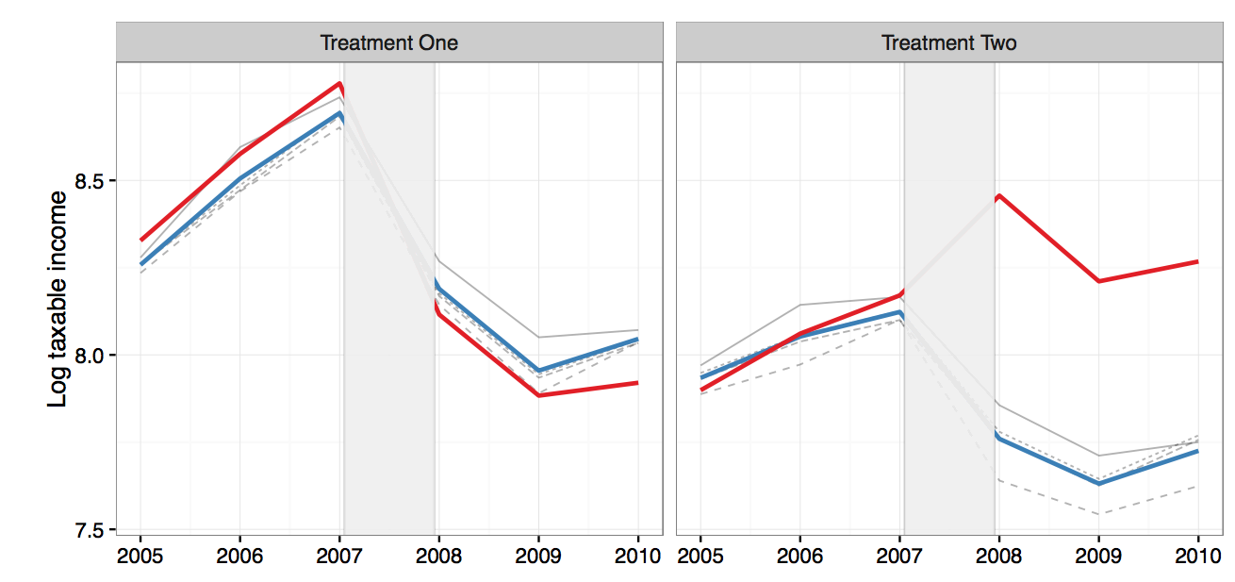
The effect of audits on self-employed US taxpayers depends on the audit outcome (Beer et al., 2020)
          Audited taxpayers
          Unaudited taxpayers
Outcome: no assessment
Outcome: positive assessment

Slide 5
So: What drives behavioral responses to tax audits?
The standard expected utility perspective: Audits provide new information that affects the perceived risk of future audits
  Audits increase (decrease) post-audit compliance if the audit detects more (less) noncompliance than expected (Slemrod, 2019)
The behavioral perspective: Taxpayers use heuristics to assess the risk of future audits, they want to make up for past “losses”, and care about reciprocity
  Taxpayers underestimate the risk of future audits (Mittone et al., 2017)
  “Availability heuristic”: Assess the probability of a future audit based on the ease of recalling the past audit experience (Kahneman & Tversky, 1973)
  Taxpayers want to make up for incurred “losses” (Erard & Feinstein, 1994)
  Audits might “crowd-out” the intrinsic motivation to comply (Mendoza et al., 2017; Hu et al., 2020)

Slide 6
This study investigates how audits affect post-audit compliance
What is the effect of “audit effectiveness”, the share of noncompliance that the agency detects, on post-audit compliance?
  Can ineffective audits explain the decline in post-audit compliance observed in some prior studies (Beer et al., 2020; Gemmell & Ratto, 2012)
How do audits affect different “types” of taxpayers?
  Relatively compliant (upper 50%) vs. Relatively noncompliant (lower 50%)
  Why a laboratory experiment?
  Allows to introduce variation in audit probability and audit effectiveness
  Allows to observe true compliance levels

Slide 7
Research design:
A variation of the standard tax compliance game
  Setup:
  Participants receive income and must decide how much they declare (28 Rounds)
  Variation in audit probability (.18 - .70) and audit effectiveness (.30 - 1), so that the risk of detection varies (.18 - .49)
  Tax rate t = 0.25 ; Fine f = 2 ; Income varies between 2,000 and 3,500 ECU
Sample:
  333 participants ; 9,324 compliance decisions ; 44% audited
  Mean age = 26 years (sd = 6.1, range: 18 – 59); 57% female
  51 % Bachelor or higher; 29% prepared own taxes in the past
  Average compliance rate = 54%; 7 to 19 audits per taxpayer

Slide 8
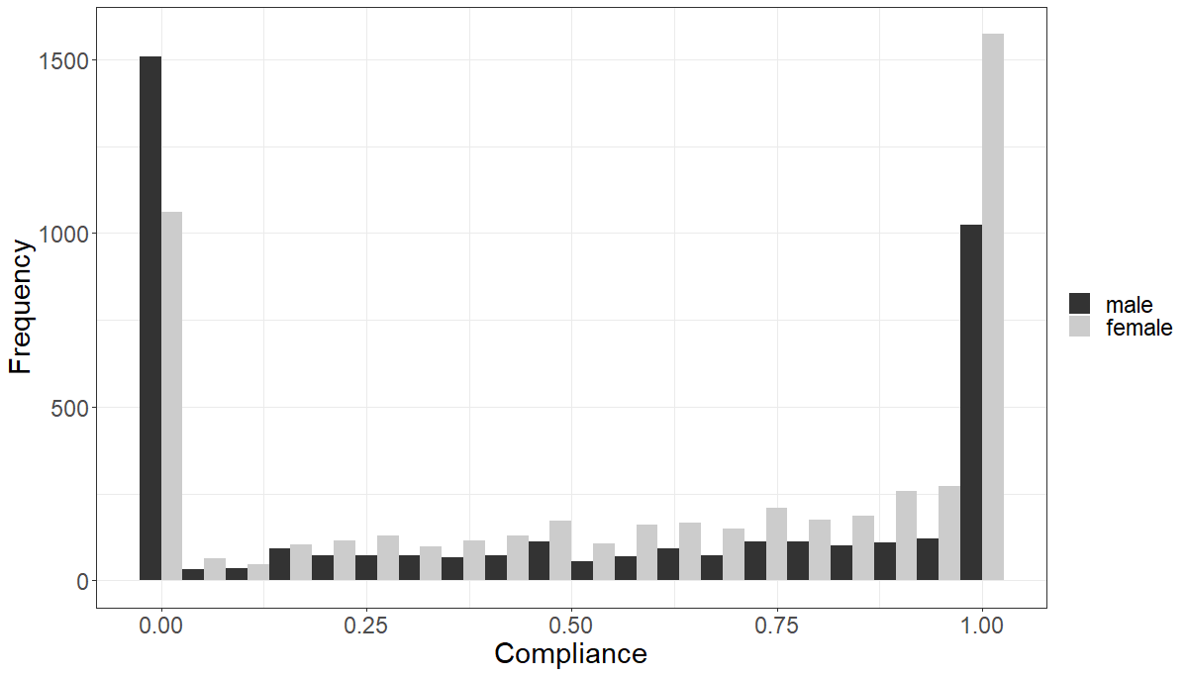
Descriptive results:
Bimodal compliance distribution

Slide 9
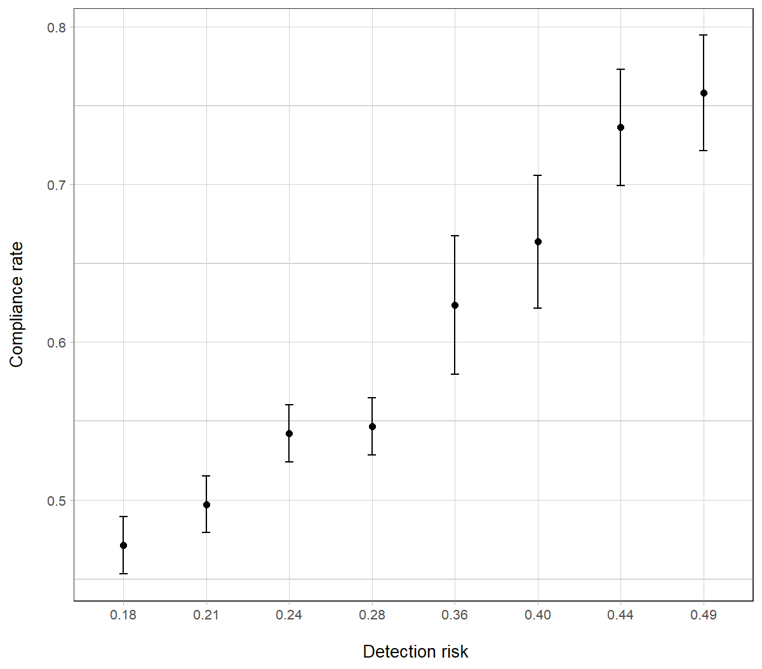
General deterrent effect of audits:
Increasing the risk of detection has a strong effect

Slide 10
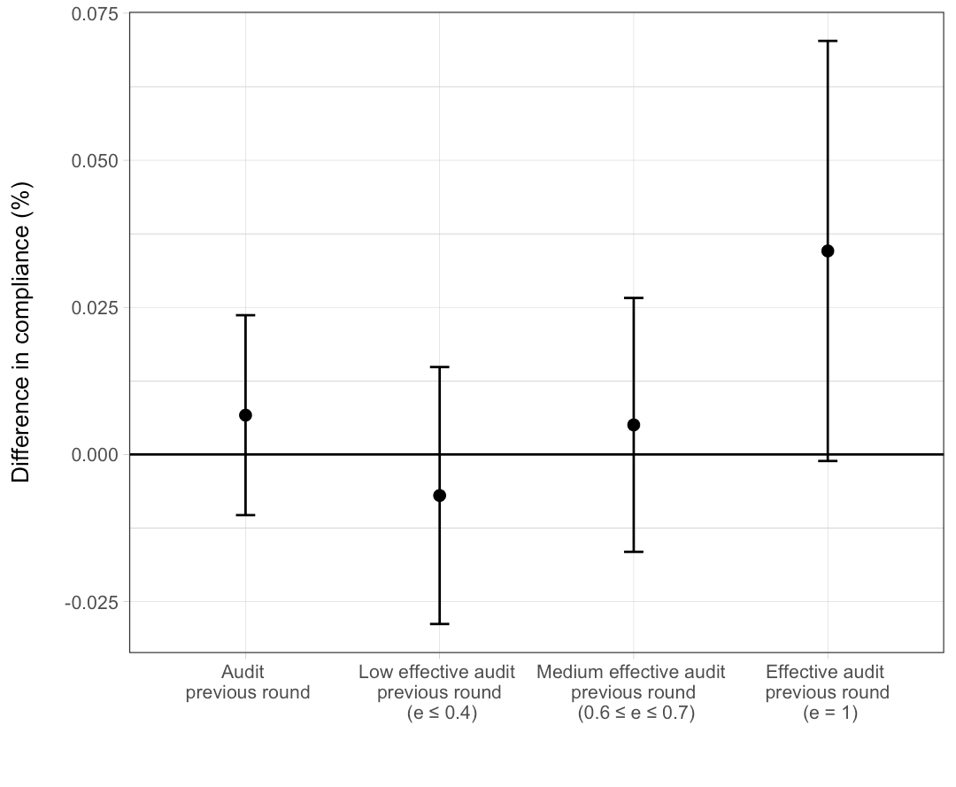
Specific deterrent effect of audits (1/2):
Only effective audits have a positive effect

Slide 11
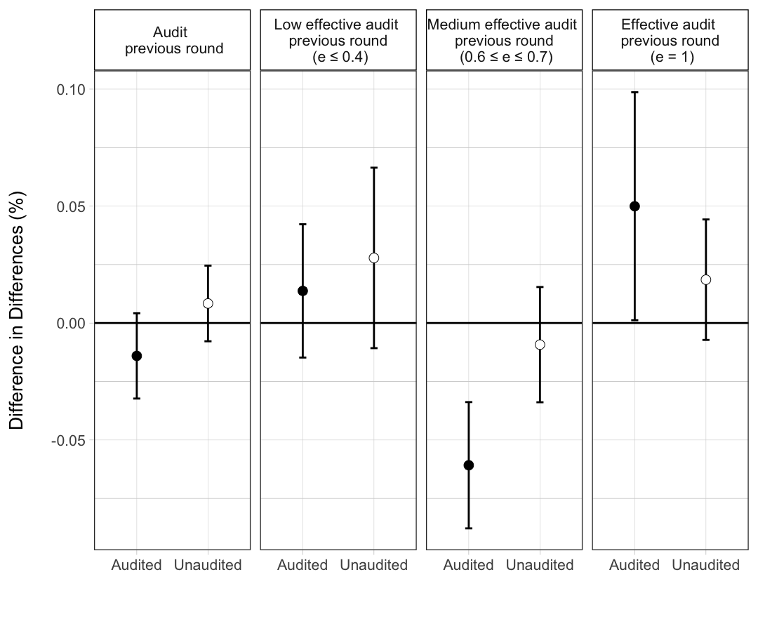
Specific deterrent effect of audits (2/2):
Responses of audited and unaudited taxpayers

Slide 12
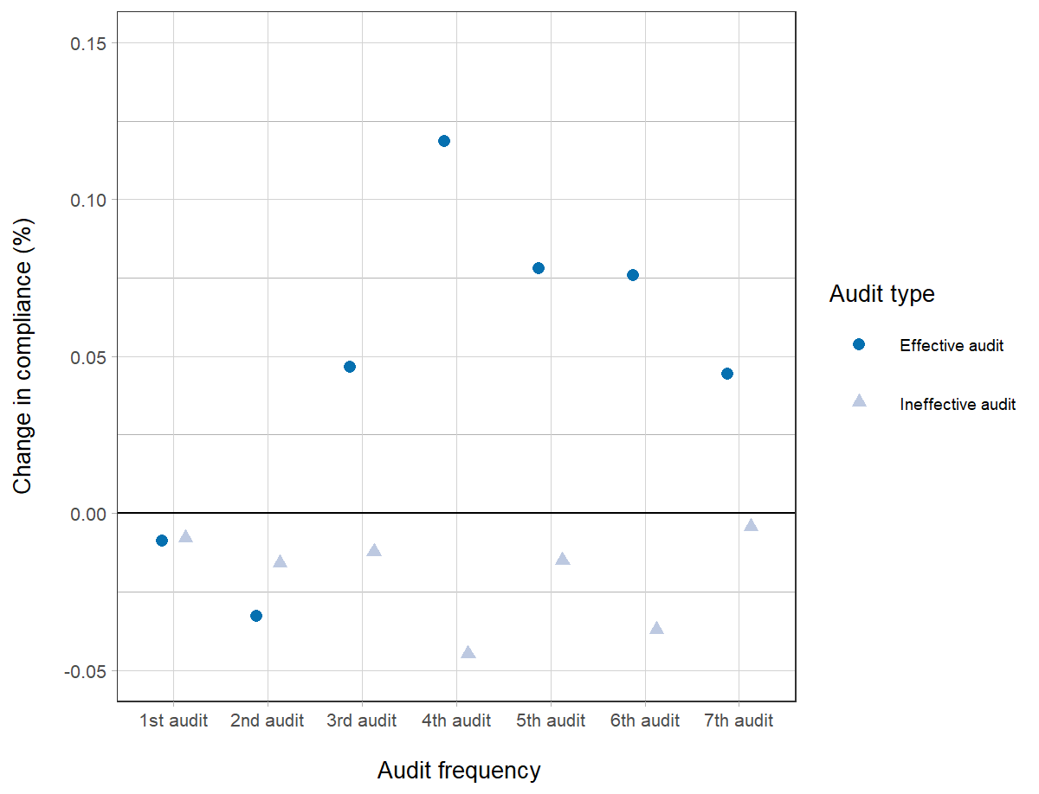
Changes in compliance after repeated audits

Slide 13
Results:
Summary
Increasing the risk of detection has a strong effect on compliance
Experiencing an audit has differential effects on post-audit tax compliance:
    Effective audits (that detect all noncompliance) improve post-audit compliance (+ 5%), Ineffective audits (that do not detect any noncompliance) have the opposite effect (- 5%)
    Relatively compliant taxpayers (upper 50%) respond more strongly to the audit experience than Relatively noncompliant taxpayers (lower 50%)
Behavioral responses to audit effectiveness do not diminish in audit frequency
Reporting behavior returns to pre-audit levels in second round after audit
No evidence for “crowding-out” effects
In sum, the audit experience (effective or not) and the taxpayer type (relatively compliant or relatively noncompliant) determine post-audit compliance

Slide 14
Implications:
How to increase the effectiveness of tax audits?
  Tax agencies should publicize any increase in their capacity to conduct audits
  Strengthen the capacity of tax audits to detect noncompliance
    Different audit types differ in their capacity to deter future noncompliance
    Focusing only on selected line items might reduce audit effectiveness
    Ambiguous nature or lenient interpretation of tax laws might undermine audit effectiveness
  Improve the targeting of noncompliant taxpayers
  Understanding psychological determinants of behavioral responses to audits might improve collection

Slide 15
Thank you for your attention!
Matthias Kasper
Matthias.Kasper@univie.ac.at

